Slide 1
iNaturalist

Slide 2
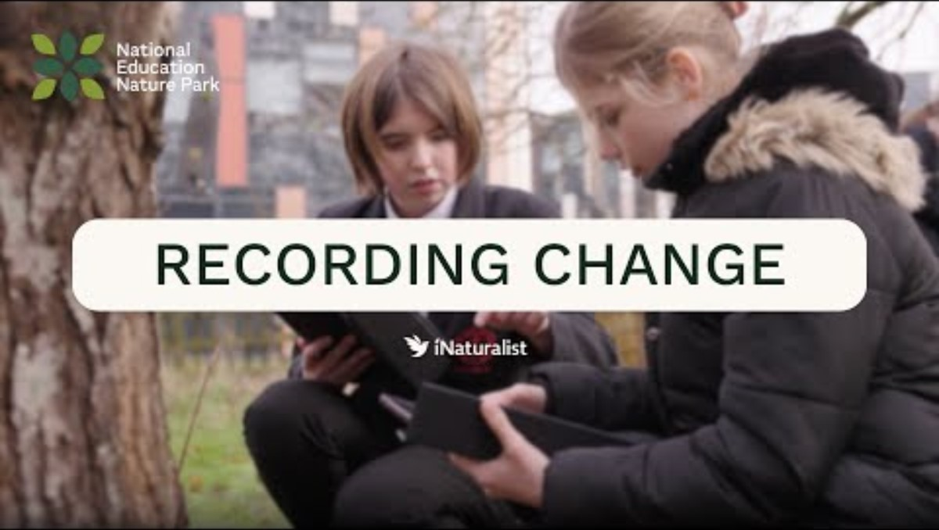

Slide 3
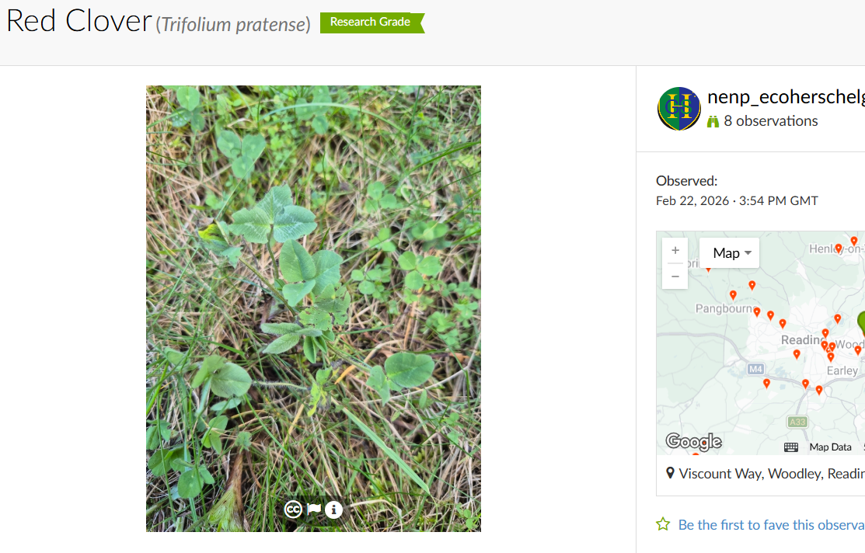
Key vocabulary and definitions for iNaturalist
Observation
Something that you see, hear or notice.
In iNaturalist, an observation is a record of a living thing at a specific time and place

Slide 4
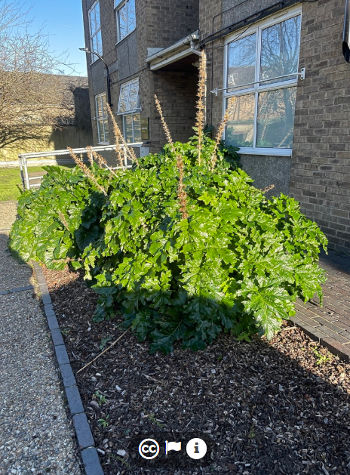
Captive or cultivated
Something that is observed because of intentional human action, rather than a natural occurrence.
Examples:
  animal in a zoo
  a flower planted in a garden
This has been planted by someone outside a building

Slide 5
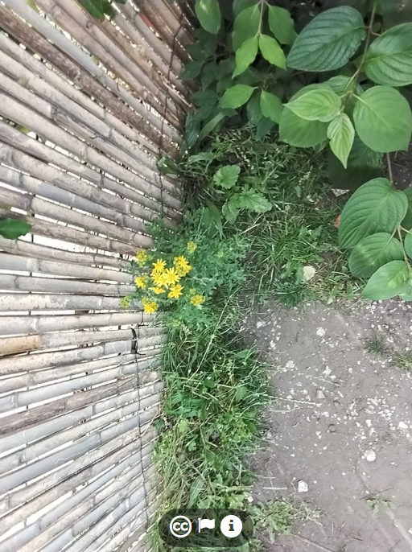
Wild
Something that is observed due to a natural occurrence.
Examples
  a fly on an animal in a zoo
  weeds or other plants that grow in a garden without being planted by people
This was not planted and is growing naturally by this wall

Slide 6
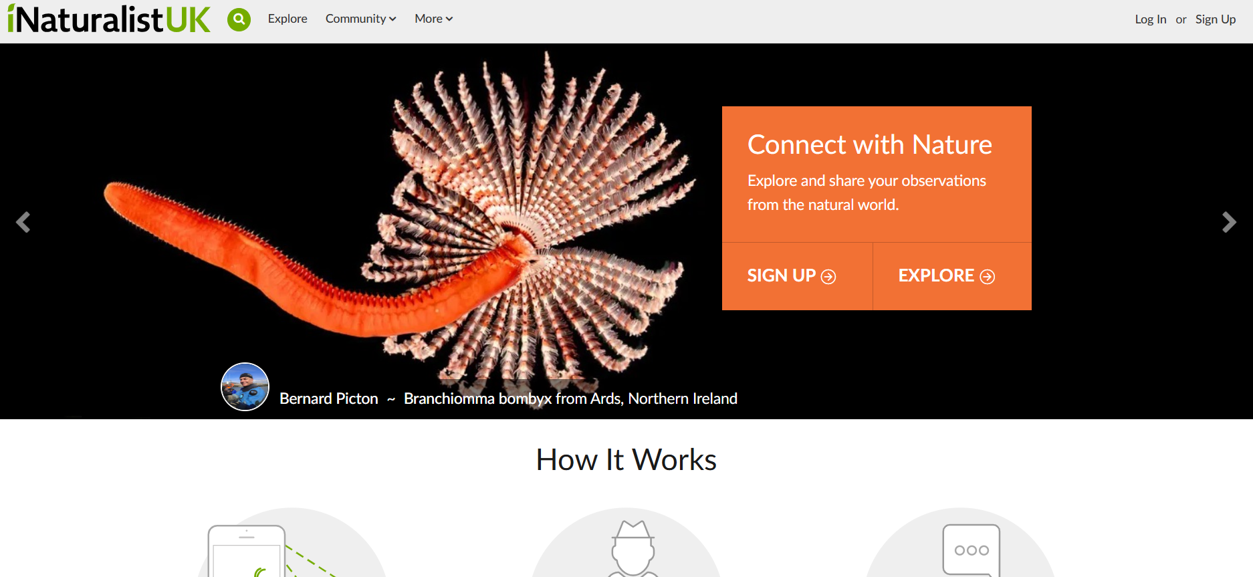
What is iNaturalist?
iNaturalist is an app and website for recording living things and where they are found.
Anyone can record a living thing and post it on iNaturalist.
Anyone can help identify what other users submit.
Notes:
Trees
Woods
Forests

Slide 7
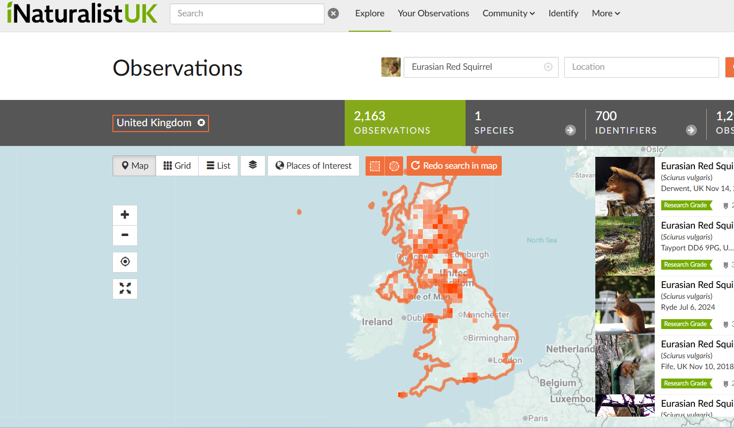
What is iNaturalist data used for?
A few things people are studying:
tracking and predicting where living things can be found
tracking where vulnerable or endangered species live
understanding what living things are doing at different times of year
Map of red squirrel observations on iNaturalistUK

Slide 8
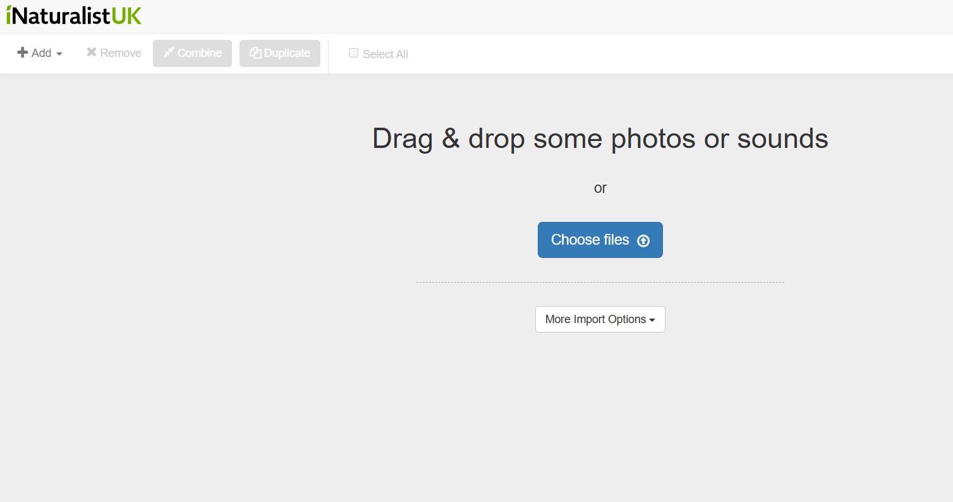
How do we use iNaturalist?
Go outside and take photos of wild living things.
Identify what is in these photos as best we can.
Upload them onto the iNaturalistUK website, or using the app.

Slide 9
What does a good observation look like?

Slide 10
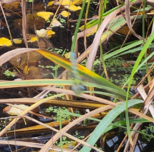
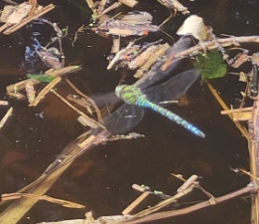
Clear photos
VS
The photo on the left is very blurry while the photo on the right is much clearer, and we can see the dragonfly

Slide 11
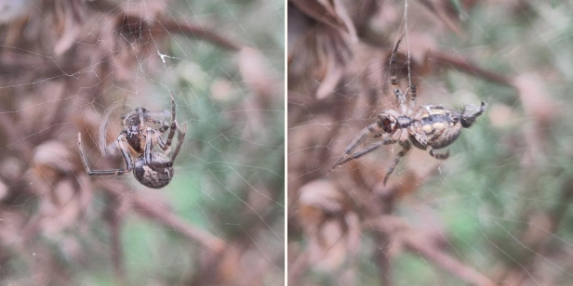
It’s okay to use more than one photo
Photos from multiple angles or photographing different parts of an organism can make them easier for us and others to identify.
Photo of top of a spider
Photo of underside of a spider

Slide 12
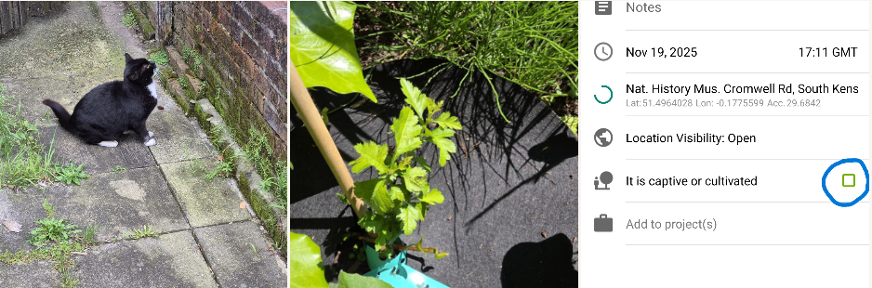
Focus on wild organisms
If you take any photos of pets, house plants or anything we have planted make sure we label it as captive or cultivated when we upload it.

Slide 13
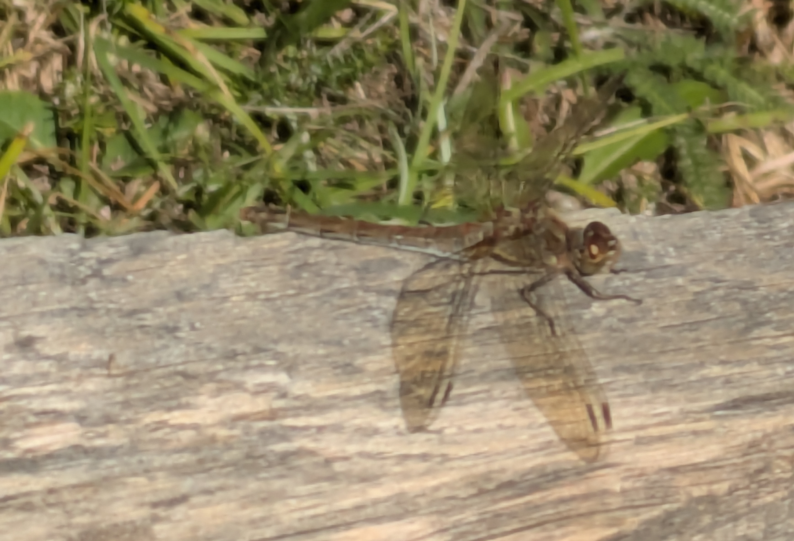
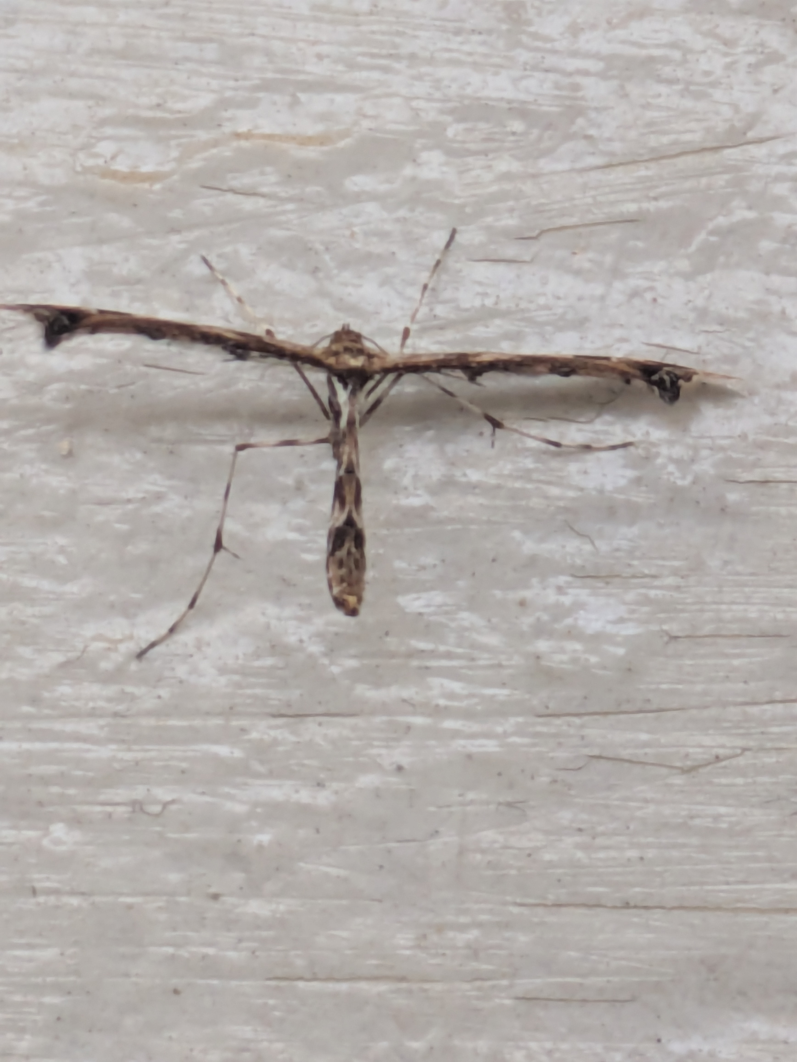
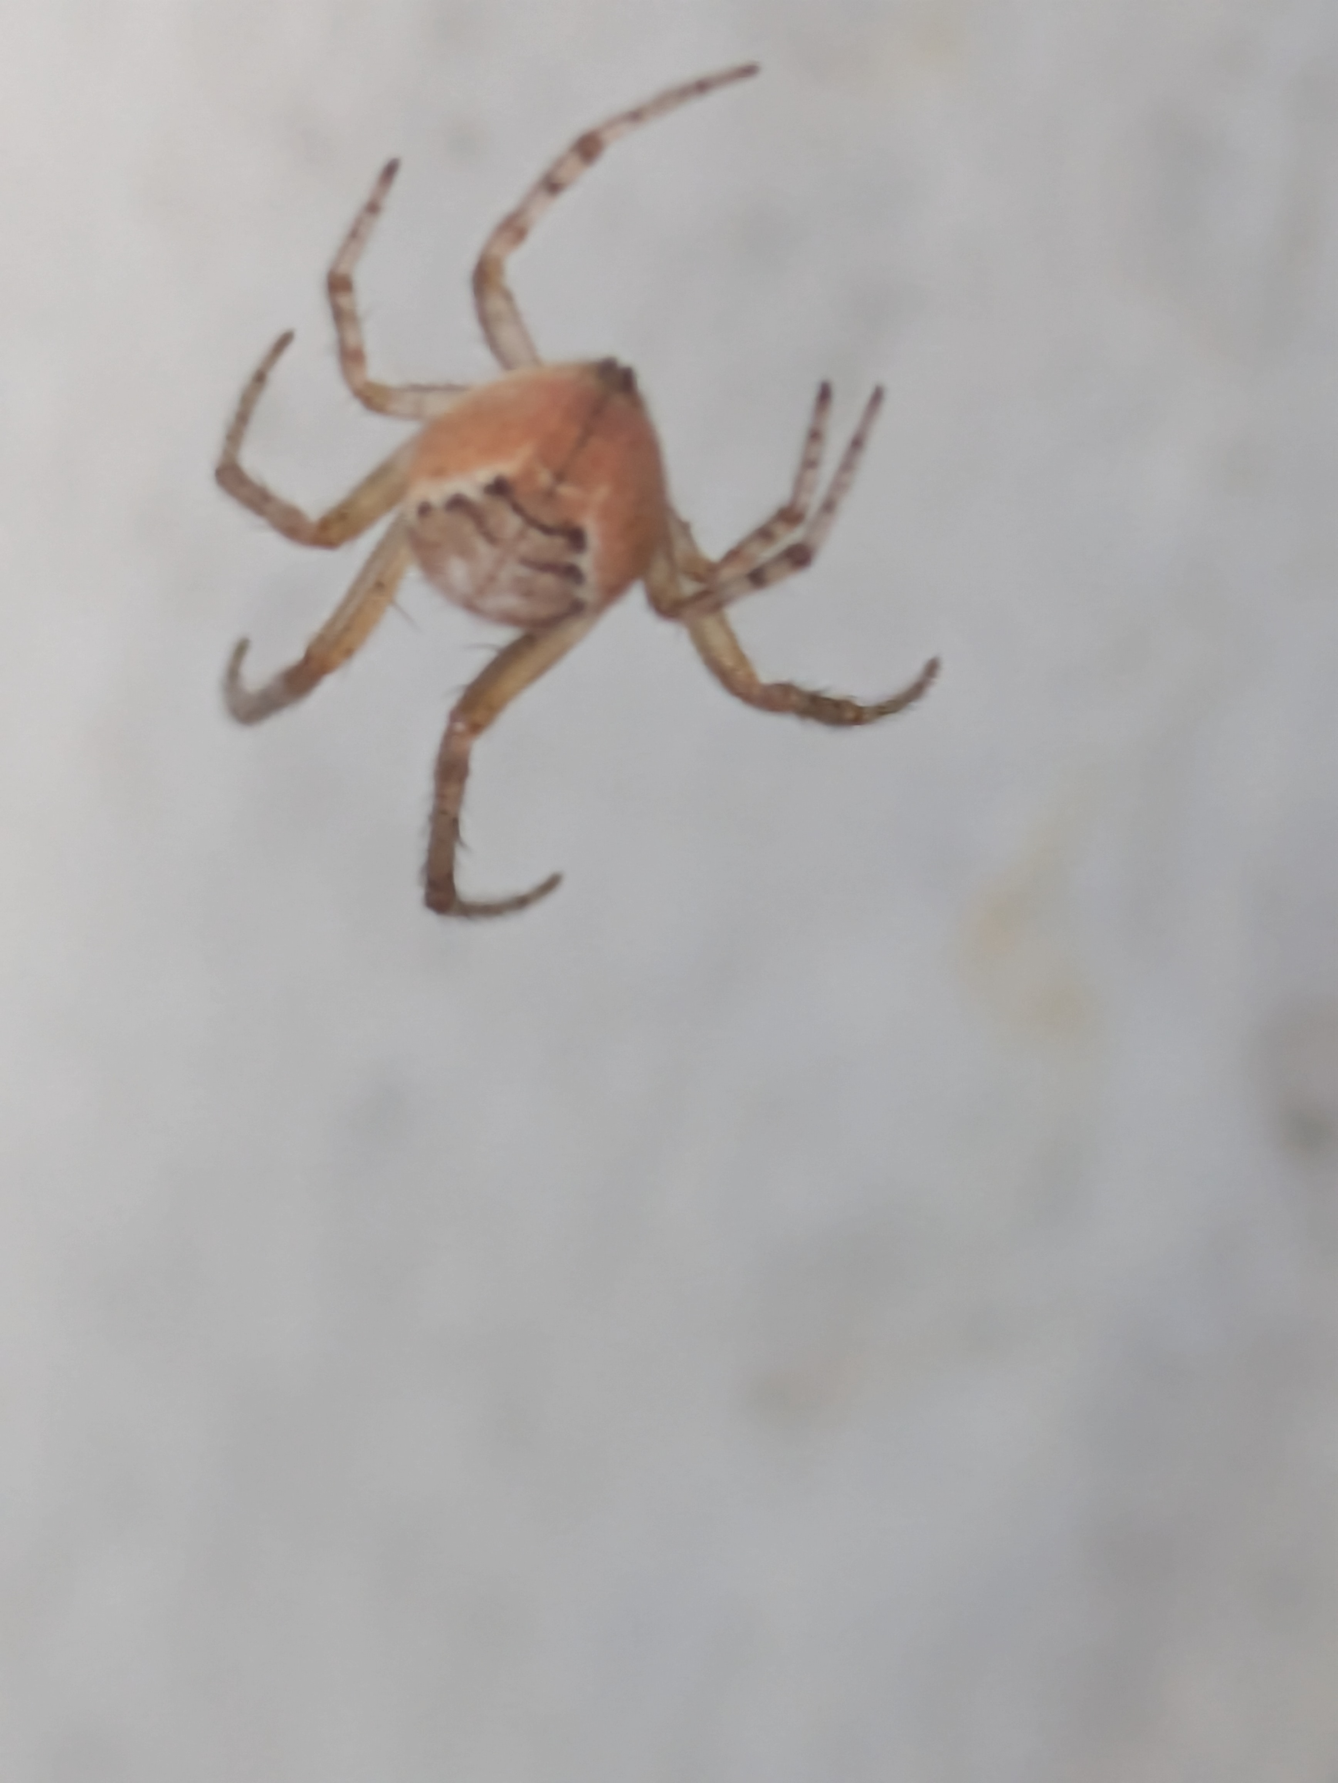
One individual organism = one observation
Make sure we are not uploading photos of different individual organisms in the same observation.
e.g. a dragonfly, a moth and a spider should each go into a separate observation

Slide 14
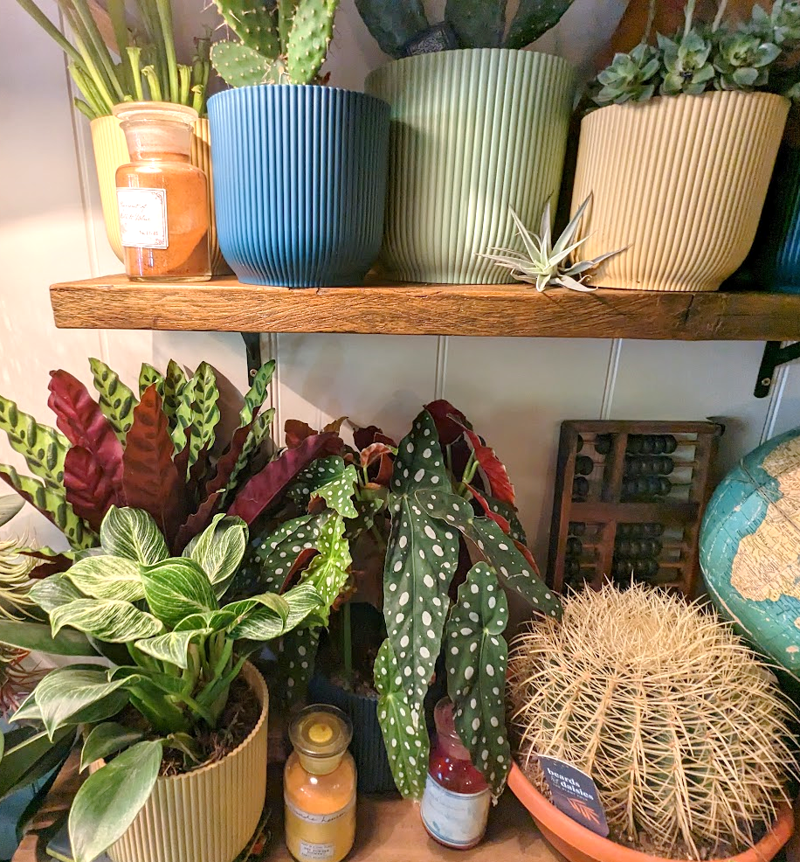
Why shouldn’t we use this photo on iNaturalist?
Living things should be:
easy to see
wild
None of these living things are wild. They are all plants that someone has put in their house.

Slide 15
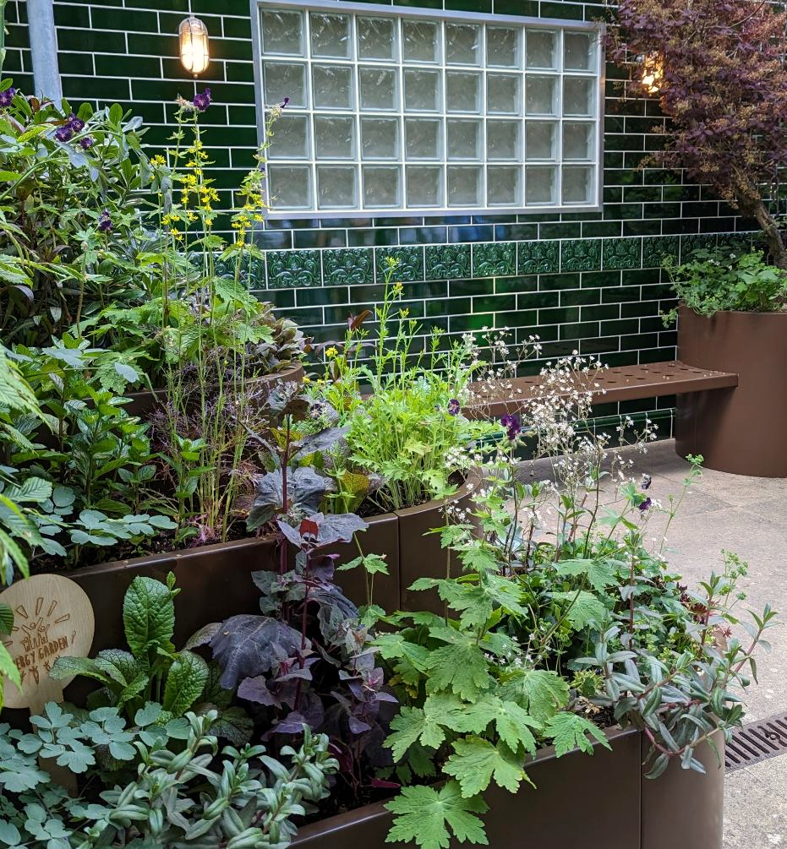
Why shouldn’t we use this photo on iNaturalist?
Living things should be:
easy to see
wild
None of these living things are wild. They are all plants that someone has planted in a flower box.

Slide 16
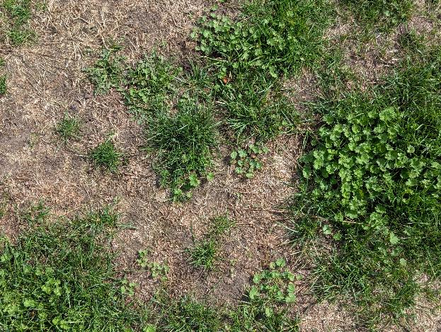
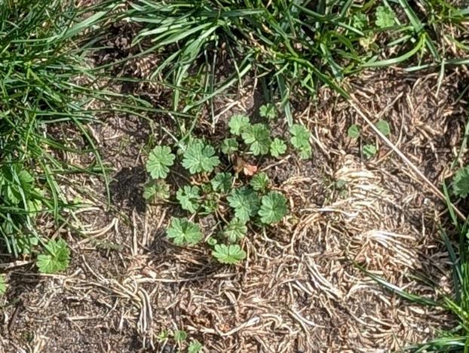
Which would be the best observation to submit to iNaturalist? Why?
Option 1
Option 2
Option 3
Notes
Notes
Plant with round leaves in the middle of the picture.
Notes:
Option 1 – Not good to submit. It is not clear what the focus of the observation is.
Option 2 – Good to submit. This is the same photo as option 1, but cropped so it is clear which plant is the focus of the observation.
Option 3 – Okay to submit. This is the same photo as option 1, but with a note added to describe which plant is the focus of the observation. Clicking on the photo in iNaturalist lets other users view it at full size, so the description, plus viewing at full size, can give other users enough information to verify the identification.

Slide 17
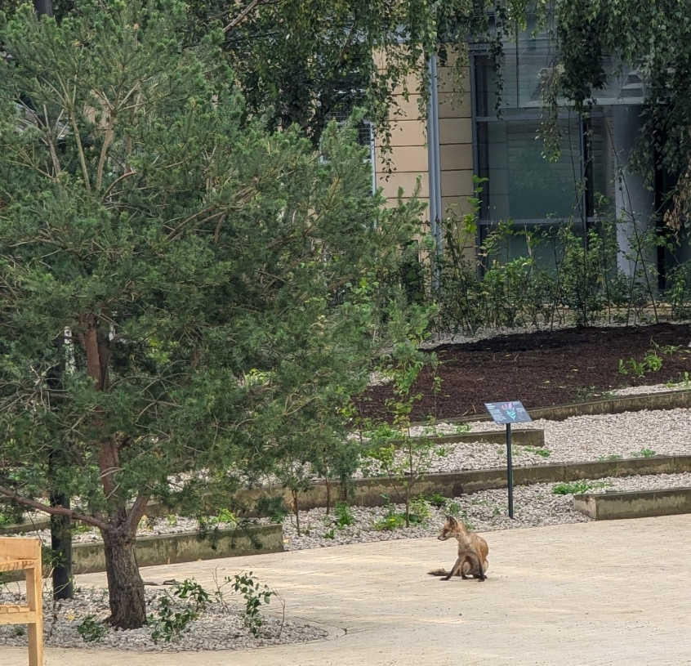
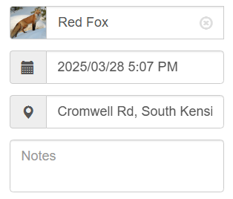
Is this a good observation of a fox?
Yes.
Users can see the animal with enough detail to tell that it is a red fox.
What could make it better?

Slide 18
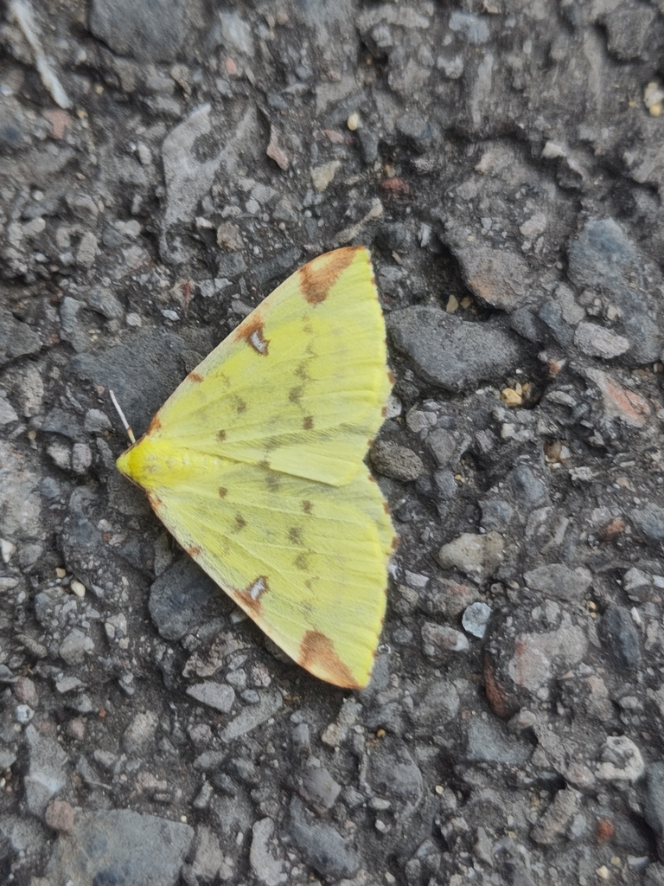
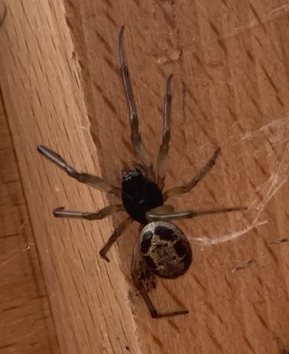
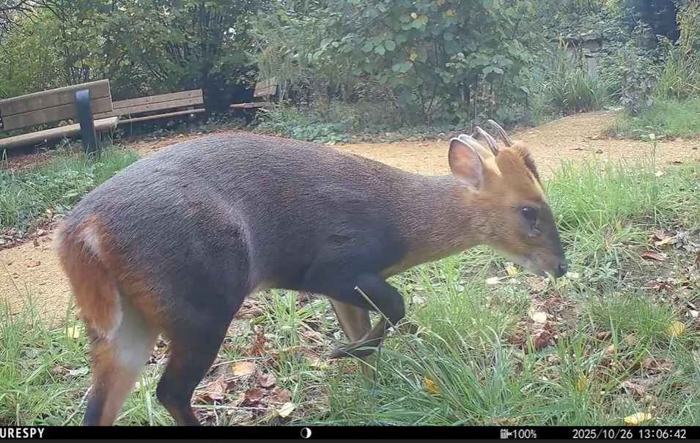
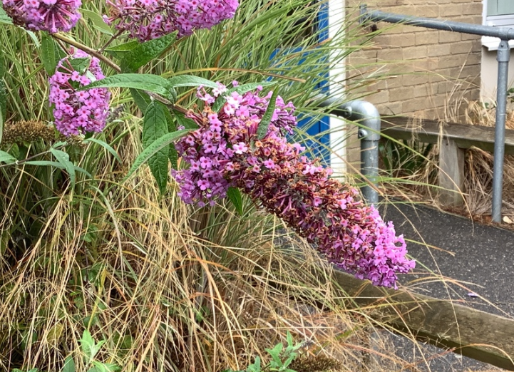
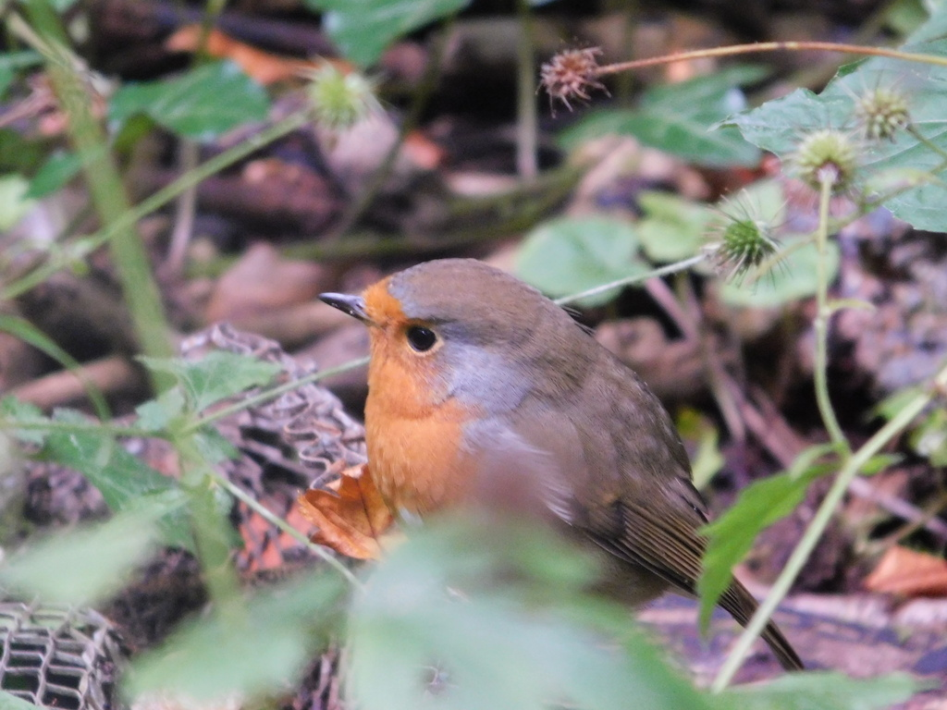
Observations from other Nature Park schools
St Barts, Newbury
Grimes Dyke, Leeds
St Barts, Newbury
Montrose Primary, Leicestershire
Colneis Junior School, Felixstowe
Notes:
Brimstone moth
Elephant Hawkmoth
Robin
Bonnets (mushroom)
Reeves's Muntjac

Slide 19
How will we use iNaturalist?
We will be going outside and taking photos of any nature we can see on our site. We will focus on things that are wild.
We will identify what is in these photos as best we can and upload them onto the iNaturalist UK website.
We will make sure that we are not taking photos of our faces or anyone's faces in the background!

Slide 20
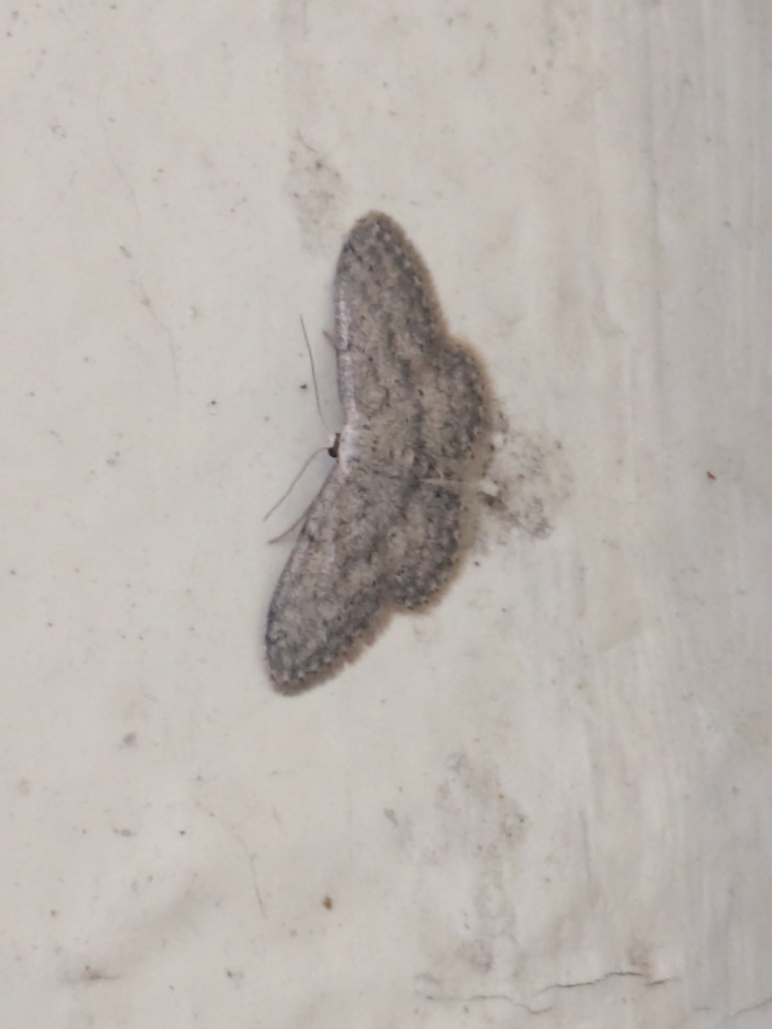
Ideas of things to look for
Whilst we are outside, try looking for a range of things such as:
  something green
  something that flies
  something living in a very grey space
  something that might live near water
  different stages of a lifecycle
  different parts of a food chain

Slide 21
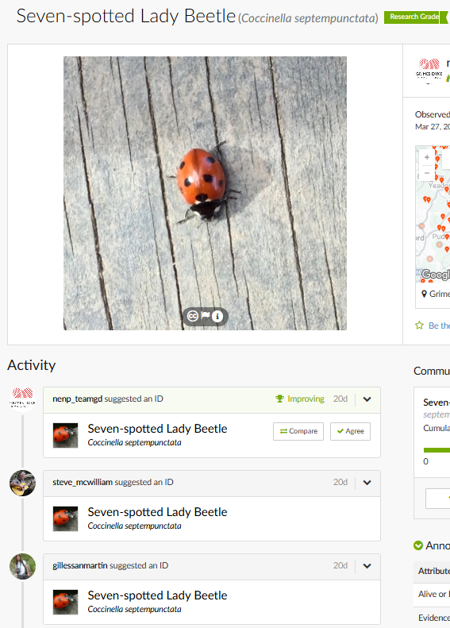
What happens after we upload our observations?
After we upload our observations, they will be visible by the worldwide iNaturalist community.
They can then agree with our identification or tell us where we might be wrong. When enough users agree on an identification it becomes research grade.
e.g This school uploaded an observation of a Seven-spotted Lady Beetle. This is now a research grade observation.

